Slide 1
AR SMART NEWSPAPER
1)SHUBHAM PATIL (58)
2)BHAVESH PATIL (55)
3)DHIRAJ NAIK (48)

Slide 2
INTRODUCTION
Printed materials from magazines to papers and even books had suffered a reduction of appealing with the arrival of the digital world. Digital news are up-to-the-second, often free and with the reach of the pocket.AR technology experts have broken the traditional approach for publishers with the introduction of a seamless experience between the screen and the printed page AR is a technology that amalgamates virtual information onto the real surrounding. It includes the use of multimedia,3D modelling sensing, intelligent interaction, real time tracking and response system and much more. In this project, we are implementing an app in which we will be having an interactive newspaper with interactive images. The newspapers will contain live images that will add extra detail and color to live and adapt.

Slide 3
PROBLEM STATEMENT
The increasing use of the Internet search function, primarily through large engines such as Google, has also changed the habits of readers. Instead of perusing general interest publications, such as newspapers, readers are more likely to seek particular writers, blogs or sources of information through targeted searches, rendering the agglomeration of newspapers increasingly irrelevant.
India’s newspapers grew by relying on advertising, a dependence that began to unravel before the pandemic stuck. Dailies have shut down and journalists have lost jobs. To revive their fortunes, they are now belatedly trying to build incomes from digital.
The conventional way of learning docs not satisfy the people and the learning activity started to feel bored and nostalgic. It seems hard for students to visualize and they will fail to focus. The newspapers want to attract new audiences especially young people to increase, they want number of readers.

Slide 4
LITERATURE SURVEY
Sr No | Author Name / Title | Methodology | Conclusion
1 | An augmented reality image registration method based on improved ORB (Author-Taneja, K., & Bhatia, S. ) | In this paper, an improved AR image registration method based on improved ORB is proposed. Firstly, the calibration image and video frame image feature points are obtained by the improved FAST feature detection algorithm. Then, the binary descriptor of BRISK, which using the custom domain sampling pattern is used for feature description, and the scale invariance of the traditional ORB algorithm is improved | The experimental results show that the AR image registration method proposed in this paper can obtain higher feature point registration rate, and has better real-time performance, which can better meet the application needs of AR image registration
2 | Augmented Reality Application for Newspapers (Author-Ihtiram Raza Khan, Anuj Goyal, Mehtab Alam) | In this research paper, they are implementing an app in which we will be having an interactive newspaper with interactive images. | They will be using latest feature of ARKit. It will turn a boring and standard newspaper into something that is extremely interesting and it revamps the experience of reading newspaper

Slide 5
Sr No | Author Name / Title | Methodology | Conclusion
3 | Augmented Reality Dynamic Image Recognition Technology Based on Deep Learning Algorithm (Author- Qiuyun Cheng , Sen Zhang, Shukui Bo , Dengxi Chen , Haijun Zhang) | This paper combines a convolutional neural network that can learn good feature information with integrated learning that has good recognition effects. In the recognition tasks of the MNIST database and the CIFAR-10 database, comparison experiments were performed by adjusting the hierarchical structure, activation function, descent algorithm, data enhancement, pooling selection, and number of feature maps of the improved convolutional neural network. | The research results show that under certain experimental conditions, the dynamic image recognition results have dropped to a very low error rate in the MNIST database, and the error rate in the CIFAR-10 database is also ideal.
4 | Capabilities of ARCore and ARKit Platforms for AR/VR Applications (Author- Paweł Nowacki and Marek Woda) | In this paper ARCore and ARkit capabilities were scrutinized and compared. Authors established comparison criteria for both platforms, developed test applications and ran comparison tests. Obtained results can be a help in choosing the right framework to speed up prototyping and development of modern AR/VR applications. | They have done a comprehensive comparison of these new frameworks in the following respects: general performance (CPU/memory use), mapping of planes on various surface types, influence of light and movement on mapping quality etc.

Slide 6
Sr No | Author Name / Title | Methodology | Conclusion
5 | Examining augmented reality in journalism: Presence, knowledge gain, and perceived visual authenticity (Tanja Aitamurto, Laura Aymerich-Franch, Jorge Saldivar, Catherine Kircos, Yasamin Sadeghi, Sukolsak Sakshuwong) | In this paper, R in journalism was discussed. Photorealistic visuals are used in news to support the journalistic norms of accuracy and authenticity. According to these aspirational norms, visual journalism should depict events in a comprehensive, realistic, and truthful manner. These norms provide a foundation for journalism’s role as a truth-teller in society. By claiming to operate within these normative boundaries, journalism differentiates itself from other communication practices, such as advertising and propaganda. | With its immersive features and 3D renderings of objects, AR has the potential to contribute to the perceived accuracy, authenticity, and credibility of visuals, similar to video and multimedia. This, in turn, can increase the perceived credibility of news reporting. Perceived realism and sense of presence in VR have been shown to have a positive association.

Slide 7
Proposed Methodology
The main objective of this project is to develop an iOS/android newspaper application which uses augmented reality; languages used will be swift, ShadderLab and C#.
We will be using latest feature of Vuforia to turn our newspaper into a magical newspaper that will play the content that is relevant to the image that is being detected.
In our application The back camera of the device will search for a scene and when it recognizes the scene in the newspaper the video is played in its position which livens up the experience of reading a news paper.
A complete performance analysis, testing, validation, and verification is to be carried out in future work.

Slide 8
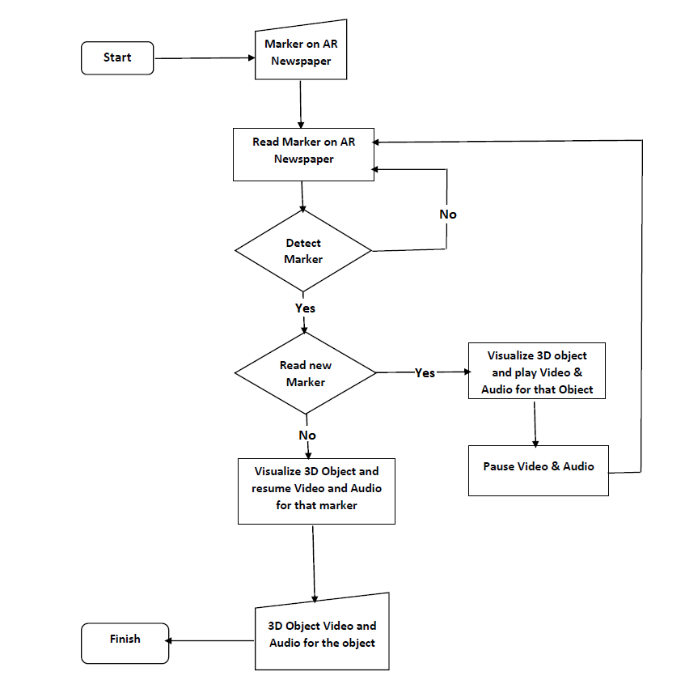
FLOWCHART

Slide 9
Detail of Hardware and Software
Hardware Requirements
Android Smartphone
2GB + RAM
Camera
Software Requirements
Vuforia
Unity
Visual Studio

Slide 10

EXAMPLE

Slide 11
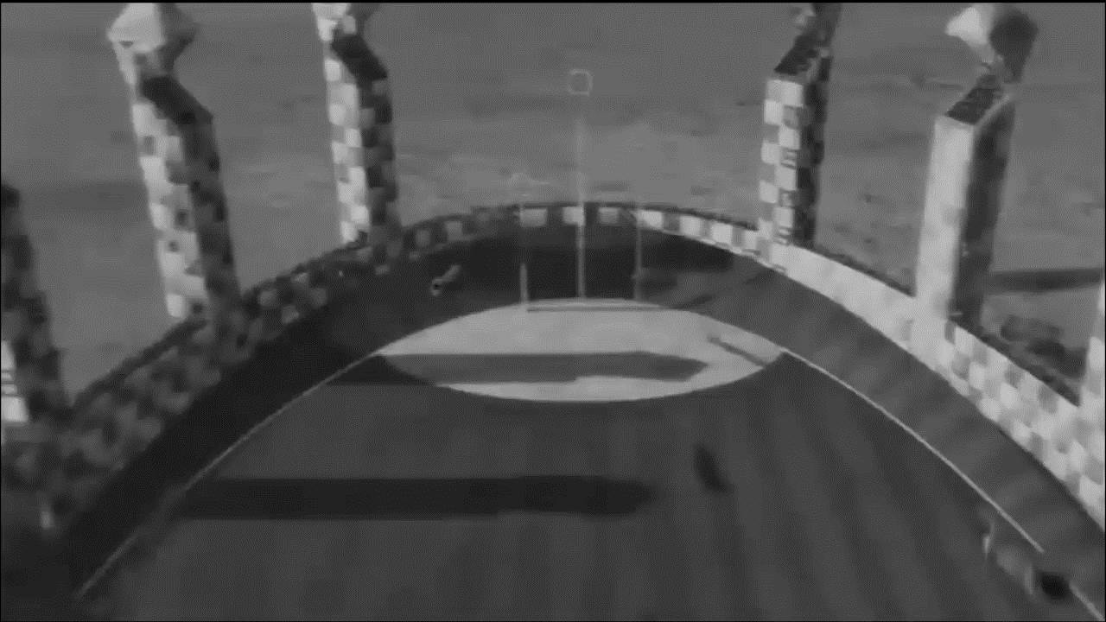
IMPLEMENTATION
Fig: The app opens the camera application in scan mode and when we Fill the screen with the photo to be scanned., The photo is automatically scanned as a Markers and Video related to that photo is played on position of the photo in app

Slide 12
CONCLUSION
We can create a successful way of human interaction with newspaper with the help of AR Smart Newspaper, So by taking advantages of digital boom we can strike a balance between AR and Newspaper. For future developments it can be enhanced by developing this system for big newspapers or magazines.

Slide 13
REFERENCE
An augmented reality image registration method based on improved ORB - Mingzhi Cheng, Luyue Zhang, Long LiuSeed Sowing arduino. (2019).
Augmented Reality Application for Newspapers - Ihtiram Raza Khan, Anuj Goyal, Mehtab Alam
Examining augmented reality in journalism: Presence, knowledge gain, and perceived visual authenticity Tanja Aitamurto, Laura Aymerich-Franch, Jorge Saldivar, Catherine Kircos, Yasamin Sadeghi, Sukolsak Sakshuwong Multi-Agent Planning for Coordinated Robotic Weed Killing(2018)
Augmented Reality Dynamic Image Recognition Technology Based on Deep Learning Algorithm - Author: Qiuyun Cheng , Sen Zhang, Shukui Bo , Dengxi Chen , Haijun Zhang
https://developers.google.com/ar/develop/java/quickstart
https://www.journaldev.com/21479/android-augmented-reality-arcore-example
https://code.tutsplus.com/tutorials/android-sdk-augmented-reality-camera-sensor-setup--mobile-7873

Slide 14
Thank You

